Slide 1





Bachelor in Data and Business Analytics
Statistics & Probability for Data Management & Analysis
Exploratory Factor Analysis: Principle Component Analysis

Slide 2
Outline
 | EFA
01
 | Intro
 | PCA
02
The Basics
 | PCA
03
The Math
Hands-on
04
Crime
Case-Study
Principle Component Analysis

Slide 3

Learning Objectives
Differentiate factor analysis techniques from other multivariate techniques.
Distinguish between exploratory and confirmatory uses of factor analytic techniques.
Distinguish between R and Q factor analysis.
Define PCA and understand its applications.
Understand the math behind PCA.
Carry out a PCA analysis using SPSS.
Principle Component Analysis

Slide 4
Learning Objectives
Assess how many principle components are needed.
Interpret principle components scores.
Determine when a PCA should be based on variance-covariance matrix or correlation matrix.
Identify the differences between component analysis and common factor analysis models.
Understand the main limitations of factor analysis.
Principle Component Analysis

Slide 5
Introduction
Exploratory Factor Analysis (EFA): interdependence technique whose primary purpose is to define the underlying structure among the variables in the analysis.
Exploratory factor analysis examines the interrelationships among a large number of variables and then attempts to explain them in terms of their common underlying dimensions: The Factors.
Exploratory factor analysis does not have independent and dependent variables; all variables are considered simultaneously.
Principle Component Analysis

Slide 6
Introduction
Exploratory factor analysis objectives:
Data summarization
= derives underlying dimensions that, when
interpreted and understood, describe the data in a much smaller number of concepts than the original individual variables.
Data reduction
= extends the process of data summarization by
deriving an empirical value (factor score or summated scale) for each dimension (factor) and then substituting this value for the original values.
Principle Component Analysis

Slide 7
Illustration I
Copyright © 2010 Pearson Education, Inc., publishing as Prentice-Hall.
Correlation Matrix for Nine Store Image Elements
 | V1 | V2 | V3 | V4 | V5 | V6 | V7 | V8 | V9
V1 Price Level | 1.00
V2 Store Personnel | .427 | 1.00
V3 Return Policy | .302 | .771 | 1.00
V4 Product Availability | .470 | .497 | .427 | 1.00
V5 Product Quality | .765 | .406 | .307 | .472 | 1.00
V6 Assortment Depth | .281 | .445 | .423 | .713 | .325 | 1.00
V7 Assortment Width | .354 | .490 | .471 | .719 | .378 | .724 | 1.00
V8 In-Store Service | .242 | .719 | .733 | .428 | .240 | .311 | .435 | 1.00
V9 Store Atmosphere | .372 | .737 | .774 | .479 | .326 | .429 | .466 | .710 | 1.00
Question: are all of these elements separate in their evaluative properties or do they group into some general areas of evaluation?
Example: do all the product elements group together? Where does price level fit, or is it separate? How do the in-store features relate to one another?
Principle Component Analysis

Slide 8
Illustration I (Cont´)
Copyright © 2010 Pearson Education, Inc., publishing as Prentice-Hall.
Correlation Matrix for Variables after Grouping Using Factor Analysis: shaded areas
 | V₃ | V₈ | V₉ | V₂ | V₆ | V₇ | V₄ | V₁ | V₅
V₃ Return Policy | 1.00
V₈ In-store Service | .733 | 1.00
V₉ Store Atmosphere | .774 | .710 | 1.00
V₂ Store Personnel | .741 | .719 | .787 | 1.00
V₆ Assortment Depth | .423 | .311 | .429 | .445 | 1.00
V₇ Assortment Width | .471 | .435 | .468 | .490 | .724 | 1.00
V₄ Product Availability | .427 | .428 | .479 | .497 | .713 | .719 | 1.00
V₁ Price Level | .302 | .242 | .372 | .427 | .281 | .354 | .470 | 1. 00
V₅ Product Quality | .307 | .240 | .326 | .406 | .325 | .378 | .472 | .765 | 1.00
In-store experience of shoppers
Product assortment & availability
Product quality & price
Principle Component Analysis

Slide 9
Factor Analysis Decision Process
1.
Objectives
2.
Design
5.
Interpretation & Validation
Factor Analysis
3.
Assumptions
4.
Model
Principle Component Analysis

Slide 10
Research Problem
Is the analysis exploratory or confirmatory? Select the objectives:
Data summarization & identifying structures Data reduction
Stage 1
Confirmatory
Structural Equation Modelling
Explanatory
Stage 2
Select the type of type of Factor Analysis:
What is being grouped – variables or cases?
Cases
Q-type factor analysis or cluster analysis
Variables
R-type factor analysis
Research Design What variables are included? How are the variables measured? What is the desired sample size?
Stage 3
Assumptions Statistical consideration of normality, linearity, and homoscedasticity Homogeneity of sample Conceptual linkage
Stage 4
10

Slide 11
Exploratory vs Confirmatory
Exploratory Factor Analysis (EFA) = is used to discover the factor structure of a construct and examine its reliability. It is data driven.
Confirmatory Factor Analysis (CFA) = is used to confirm the fit of the hypothesized factor structure to the observed (sample) data. It is theory driven.
Principle Component Analysis

Slide 12
Factor Analysis Design
Factor analysis is performed most often only on metric variables, although specialized methods exist for the use of dummy variables. A small number of “dummy variables” can be included.
If a study is being designed to reveal factor structure, strive to have at least five variables for each proposed factor.
For sample size:
Must have more observations than variables.
The minimum absolute sample size should be 50 observations.
Maximize the number of observations per variable, with a minimum of five variables per factor and at least ten observations per variable.
Principle Component Analysis

Slide 13
CFA vs PCA
Common Factor Analysis: Factors are based on a reduced correlation matrix. That is, communalities (total amount of variance an original variables shares with all other variables included in the analysis) are inserted in the diagonal of the correlation matrix, and the extracted factors are based on the common variance, with specific and error variance excluded.
Principle Component Analysis: Factors are based on total variance. With component analysis, unities (1) are used in the diagonal of the correlation matrix; implying that all the variance is common or shared.
Criteria for selection:
Objectives of the factor analysis.
Amount of prior knowledge about the variance in the variables.
Principle Component Analysis

Slide 14




CFA vs PCA
Extraction Method Determines the Types of Variance Carried into the Factor Matrix
Diagonal Value Variance
Total Variance
PCA: Unity (1)
Common
Specific and Error
CFA: Communality
Specific variance: variance of each variable unique to that variable; i.e. not explained or associated with other variables.
Variance extracted
Variance not used
Error variance: variance of a variable due to errors in data collection or measurement.
Principle Component Analysis

Slide 15
What?
Principle Component Analysis
Why?
Dimension Reduction, Pattern Recognition
The sheer size of data is a main bottleneck for performance of many machine learning algorithms.
The main goal of PCA analysis is to identify patterns in data, by detecting correlation between variables. If a strong correlation between variables exists, reducing the dimensionality makes sense.
PCA is finding the directions of maximum variance in high-dimensional data and projecting it onto a smaller dimensional subspace while retaining most of the information.
15

Slide 16
Outline
 | PCA
02
The Basics
 | EFA
01
 | Intro
PCA
03
The Math
Hands-on
04
Crime
Case-Study
Principle Component Analysis

Slide 17
Basics
Principal Component Analysis (PCA): mathematical technique that uses eigenvalues and eigenvectors to find principal components of a dataset (i.e. components that explain most of the variance in a data set).
In a data set, the Principle Components are the underlying structure, the directions where the data is most spread out (i.e. straight line where the data is most spread out when projected onto it).
PCA is an exploratory data analysis technique used in data reduction
(i.e. to reduce the dimensions of a data set into its basic components).
A test typically conducted prior to regression analysis.
PCA is a change of variable space.
https://georgemdallas.wordpress.com/2013/10/30/principal-component-analysis-4-dummies-eigenvectors-eigenvalues-and-dimension-reduction/
Principle Component Analysis

Slide 18













Illustration
a) Vertical line
Consider the following example:
Find the direction where there is most variance
b) Horizontal line
ev 1
https://georgemdallas.wordpress.com/2013/10/30/principal-component- analysis-4-dummies-eigenvectors-eigenvalues-and-dimension-reduction/
Principle Component Analysis

Slide 19
Eigenvalues & Eigenvectors
An eigenvector is a direction, whereas an eigenvalue is a number, telling you how much variance (spread) there is in the data in that direction.
Usually, the eigenvector with the highest eigenvalue is the principal component of a dataset.
The amount of eigenvectors/values that exist equals the number of dimensions the data set has.
WHY?
Eigenvectors put the data into a new set of dimensions, and these new dimensions must be equal to the original amount of dimensions.
https://georgemdallas.wordpress.com/2013/10/30/principal-component-analysis-4-dummies-eigenvectors-eigenvalues-and-dimension-reduction/
Principle Component Analysis

Slide 20
Eigenvalues & Eigenvectors: Illustration
a) Data plotted in x-y plane b) First eigenvector
y y
x
x
y
new y
new x
x
c) The two eigenvectors are perpendicular to span the whole x-y area effectively.
d) The eigenvectors have given us a much more useful axis to frame the data in. We can now re- frame the data in these new dimensions.
The number of eigenpairs corresponds to the number of variables in a dataset.
However, usually 2 or more eigenvectors explain most of the variation in the data.
Principle Component Analysis

Slide 21
Outline
 | EFA
01
 | Intro
 | PCA
02
The Basics
 | PCA
03
The Math
Hands-on
04
Crime
Case-Study
Principle Component Analysis

Slide 22
The Math
Suppose you have a random variable X, representing the number of variables in a dataset:
⎛ X ⎞
⎜ _{X} ¹ ⎟
X = ⎜
2 ⎟
⎜ ⁝ ⎟
⎜ _{X} ⎟
⎝
p ⎠
with population variance-covariance matrix, Σ
⎞
⎜
var(X) = ⎜
⎜
⎛ σ ² σ … σ ⎟
1 p
… σ ⎟
1
12
⎜σ
_{σ} 2
21
2
2 p
⎟
⁝
⁝ ⋱ ⁝
⎟
⎜_{σ}
σ …
_{σ} 2 ⎟
⎝
p1 p 2
p ⎠
Consider the linear combinations:
Y₁ = e₁₁ X ₁ + e₁₂ X ₂ + ... + e_{1 p} X _{p}
Y₂ = e₂₁ X ₁ + e₂₂ X ₂ + ... + e_{2 p} X _{p}
⁝
Each of these equations can be thought of as a linear regression, predicting Y_{i} from X₁, X₂, …, X_{p}.
No intercept and e_{i1}, e_{i2}, …, e_{ip}
are regressions coefficients.
Y = e X + e
X + ... + e X
p
p1 1 p 2 2
pp p
Each linear combinations of the data will correspond to a principle component.
Principle Component Analysis

Slide 23
Linear Combinations of Random Variables
Yi is a random variable and has the following population variance:
p p
var(Y) = ∑∑e_{ik} e_{il}σ _{kl} = e′_{i}
∑^{e}i
k =1 l =1
In each term within the double sum, the product of the paired coefficients e_{ik} times e_{il} is multiplied by the covariance between the kth and lth variables. If Σ is the variance-covariance matrix of X, then Var(Y) = e_{i}′ Σ e_{i}.
Moreover, Yi and Yj have population covariance
cov(Y_{i} , Y_{j} ) = ∑∑e_{ik} e _{jl}σ _{kl}
k =1 l =1
p p
∑^{e} j
= e′_{i}
⎛ e_{i1} ⎞
Collect the coefficients eij into the vector
⎜ _{e} ⎟
i 2 ⎟
e = ⎜
⎜ ⁝ ⎟
i
⎜ _{e} ⎟
⎝
ip ⎠
Principle Component Analysis

Slide 24
The Math
First Principal Component (PCA1): Y1
The first principal component is the linear combination of x-variables that has maximum variance (among all linear combinations). It accounts for as much variation in the data as possible.
var(Y₁ ) = ∑∑e_{1k} e_{1l}σ _{kl} = e₁′ ∑e₁
k =1 l =1
p p
Specifically we define coefficients e11, e12, ... , e1p for the first component in such a way that its variance is maximized, subject to the constraint that the sum of the squared coefficients is equal to one. This constraint is required so that a unique answer may be obtained.
More formally, select e11, e12, ... , e1p that maximizes:
p
1 1 ∑ 1 j j =1
e′e =
2
e = 1
Principle Component Analysis

Slide 25
The Math
Second Principal Component (PCA2): Y2
The second principal component is the linear combination of x-variables that accounts for as much of the remaining variation as possible, with the constraint that the correlation between the first and second component is 0
p p
= e′₂ ∑e₂
^{var(Y}2 ⁾ ⁼ ∑∑^{e}21k ^{e}21l^{σ} kl
k =1 l =1
Select e21, e22, ... , e2p that maximizes the variance of this new component… subject to the constraint that the sums of squared coefficients add up to one:
p
e′ e = e = 1
j =1
2 2 ∑ 2 j
2
along with the additional constraint that these two components are uncorrelated.
cov(Y₁ , Y₂ ) = ∑∑e_{1k} e_{2l}σ _{kl} = e₁′ ∑e₂ = 0
k =1 l =1
p p
All subsequent principal components have this same property – they are linear combinations that account for as much of the remaining variation as possible and they are not correlated with the other principal components.
Principle Component Analysis

Slide 26
The Math
Finding the coefficients eij for a principal component?
The solution involves the eigenvalues and eigenvectors of the variance- covariance matrix.
Let λ1 through λp denote the eigenvalues of the variance-covariance matrix.
These are ordered so that λ1 has the largest eigenvalue and λp is the smallest.
Let the vectors e1 through ep denote the corresponding eigenvectors. It turns out that the elements for these eigenvectors are the coefficients of our principal components.
The variance for the ith principal component is equal to the ith eigenvalue.
var(Y_{i} ) = var(e_{i1} X ₁ + e_{i 2} X ₂ +… + e_{ip} X _{p} ) = λ_{i}
Moreover, the principal components are uncorrelated with one another.
cov(Y_{i} , Y_{j} ) = 0
Principle Component Analysis

Slide 27
Notes
All of this is defined in terms of the population variance-covariance matrix Σ
which is unknown.
However, we can estimate Σ by the sample variance-covariance matrix S.
All corresponding eigenvalues/eigenvectors are estimated.
In a PCA, we only retain the first k components. Here, we must balance two conflicting facts:
To obtain the simplest possible interpretation, we want k to be as small as possible
To avoid loss of information, we want the proportion of variation explained by the first k principle components to be large. Ideally, as close to 1 as possible
_{λ}ˆ
+ λ^{ˆ} +… + λ^{ˆ}
1 2 k _{≅ 1}
_{λ}ˆ
+ λ^{ˆ} +… + λ^{ˆ}
1
2 p
Principle Component Analysis

Slide 28
Dimension Reduction
When multicollinearity exists between the x-variables, the data may more or less fall on a line or plane in a lower number of dimensions.
For instance, imagine a plot of two x-variables that have a nearly perfect correlation. The data points will fall close to a straight line. That line could be used as a new (one-dimensional) axis to represent the variation among data points.
As another example, suppose that we have verbal, math, and total SAT
scores for a sample of students → at most two dimensions
Ultimate goal of PCA is to reduce the dimensions of d-dimensional dataset by projecting it into a k-dimensional subspace (where k < d) in order to increase the computational efficiency while retaining most of the information.
Principle Component Analysis

Slide 29
Outline
 | EFA
01
 | Intro
 | PCA
02
The Basics
 | PCA
03
The Math
Hands-on
04
Crime
Case-Study
Principle Component Analysis

Slide 30
Application: Crime Case-Study
Source: http://psych.colorado.edu/~carey/courses/psyc7291/classdatasets.htm
Metadata: 1977 crime rates by US state.
7 variables: murder, robbery, assault, burglary, larceny, and auto.
Larceny vs robbery: Robbery involves use of force, serious legal penalties. Larceny: no force, permanent deprivation of property.
50 states
Objective:
Study the covariance/correlation between the variables
Run a PCA for dimension reduction
Software: IBM SPSS (version 25).
Principle Component Analysis

Slide 31
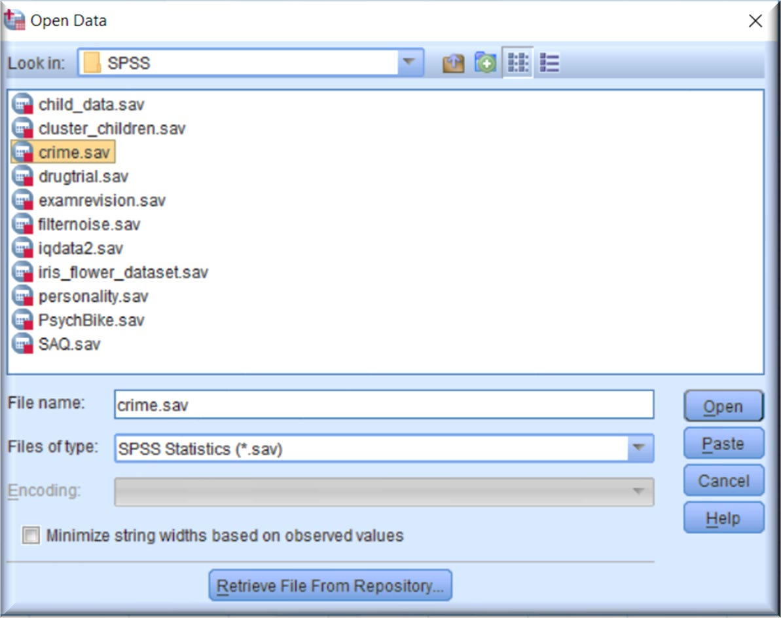
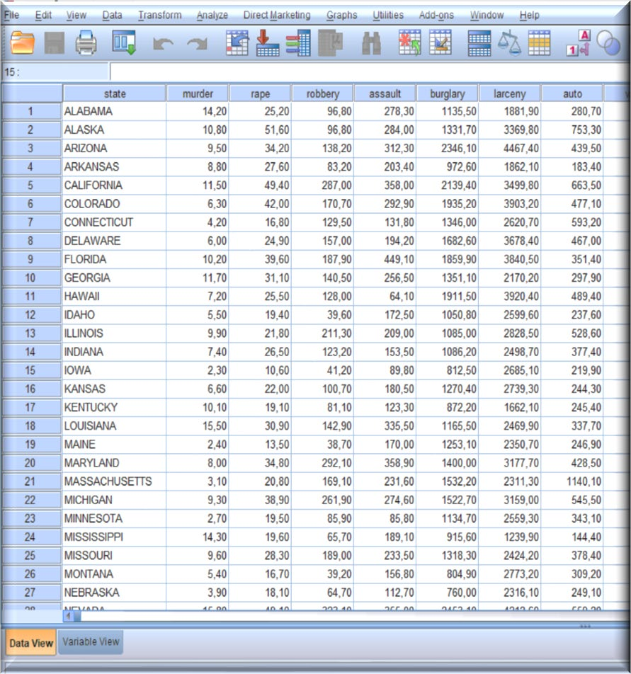
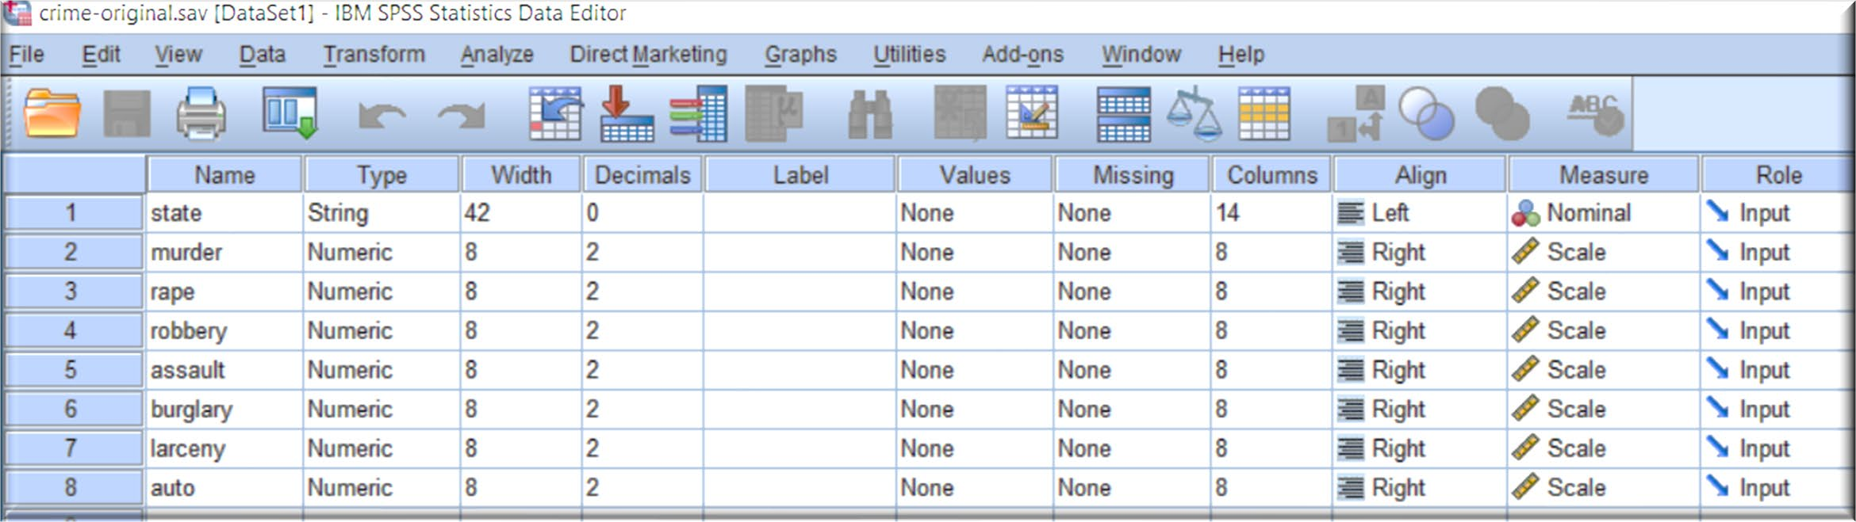
Loading File
1) Open the SPSS software
File > Open > Data
2) In the data file, notice both the
Data View and Variable View
Hands-on Case Study

Slide 32
Test Considerations
Data: The variables should be quantitative at the interval or ratio level.
Categorical data (such as religion or country of origin) are not suitable for factor analysis.
Data for which Pearson correlation coefficients can sensibly be calculated should be suitable for factor analysis.
Considerations:
The data should have a bivariate normal distribution for each pair of variables
Observations should be independent.
The factor analysis model specifies that variables are determined by common factors (the factors estimated by the model) and unique factors (which do not overlap between observed variables); the computed estimates are based on the assumption that all unique factors are uncorrelated with each other and with the common factors.
Hands-on Case Study

Slide 33
Assumptions & Considerations
You have multiple variables that should be measured at the continuous level
(although ordinal variables are very frequently used).
There needs to be a linear relationship between all variables.
You should have sampling adequacy, which simply means that for PCA to produce a reliable result, large enough sample sizes are required. Many different rules-of-thumb have been proposed. These mainly differ depending on whether an absolute sample size is proposed or if a multiple of the number of variables in your sample are used. Generally speaking, a mimimum of 150 cases, or 5 to 10 cases per variable, has been recommended as a minimum sample size.
Hands-on Case Study

Slide 34
Assumptions & Considerations
Your data should be suitable for data reduction: Multicollinearity → Assessed using MSA (measure of sampling adequacy) and Bartlett´s test of Sphericity: statistical test for the overall significance of all correlations within a correlation matrix.
There should be no significant outliers.
Homogeneity of sample factor solutions.
Hands-on Case Study

Slide 35
Assumptions: Rules of Thumb
There must be a strong conceptual foundation to support the assumption that a structure does exist before the factor analysis is performed.
A statistically significant Bartlett’s test of sphericity (sig. < .05) indicates that sufficient correlations exist among the variables to proceed.
Measure of Sampling Adequacy (MSA) values must exceed .50 for both the overall test and each individual variable. Variables with values less than
.50 should be omitted from the factor analysis one at a time, with the smallest one being omitted each time.
Hands-on Case Study

Slide 36
Running the Analysis
In SPSS, PCA involves the same steps as FA.
PCA is a multi-step procedure that might involves running the analysis 2 or 3 times.
OUTPUT
INTERPRETATION
Descriptive Statistics
Scale of measurement Scale of variance
FIRST RUN
Scree Plots
Determine the number of principle components
Communalities
Determine the number of principle components
Hands-on Case Study

Slide 37
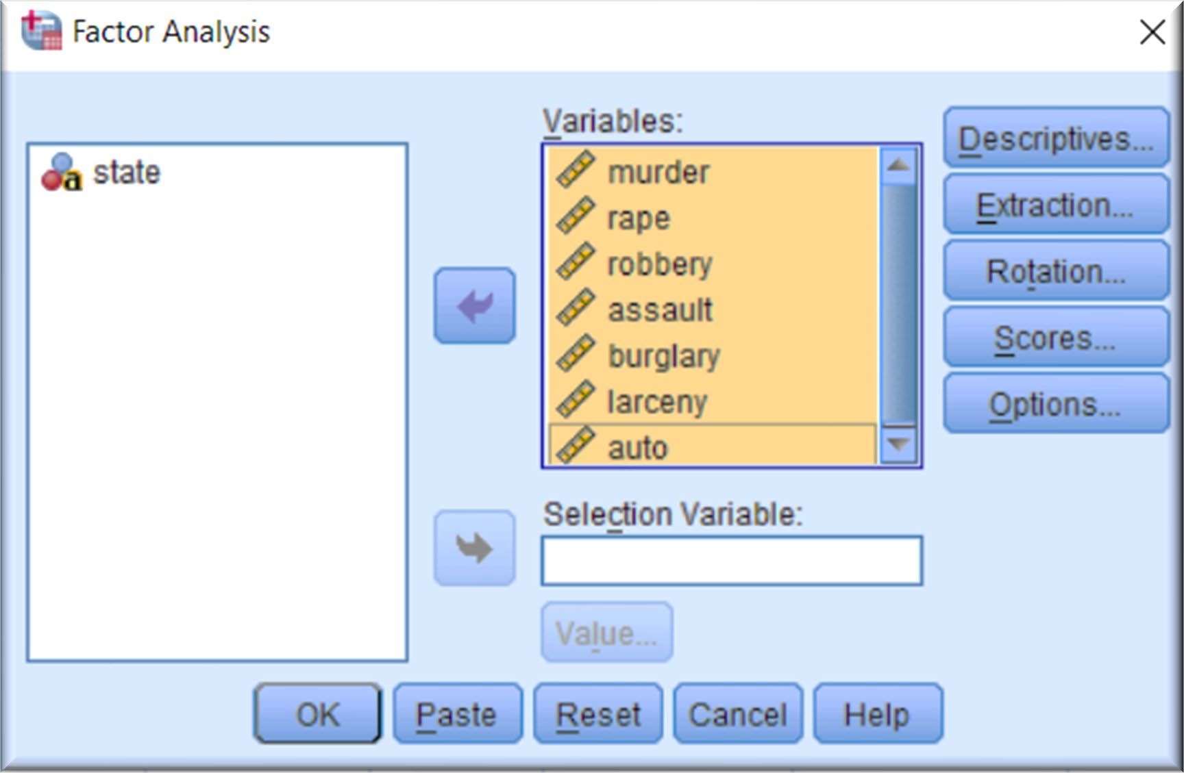
Running the Analysis
To run a principal components factor analysis, from the menus choose:
Analyze > Dimension Reduction > Factor...
Select murder through auto
as analysis variables.
Figure 1. Factor Analysis dialog
Hands-on Case Study

Slide 38
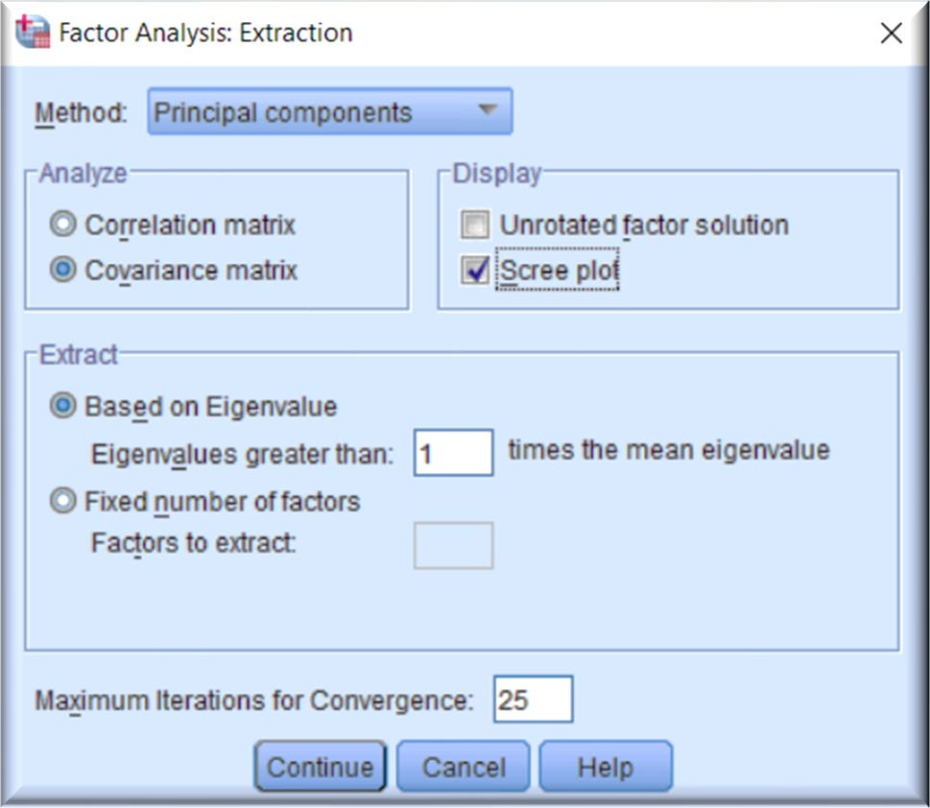
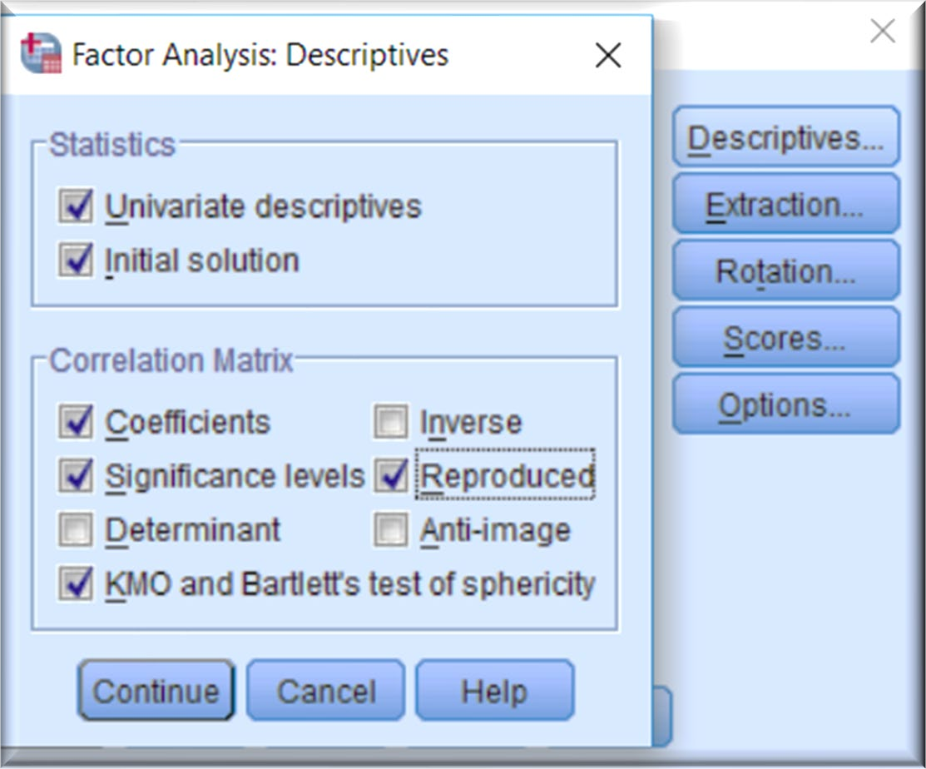
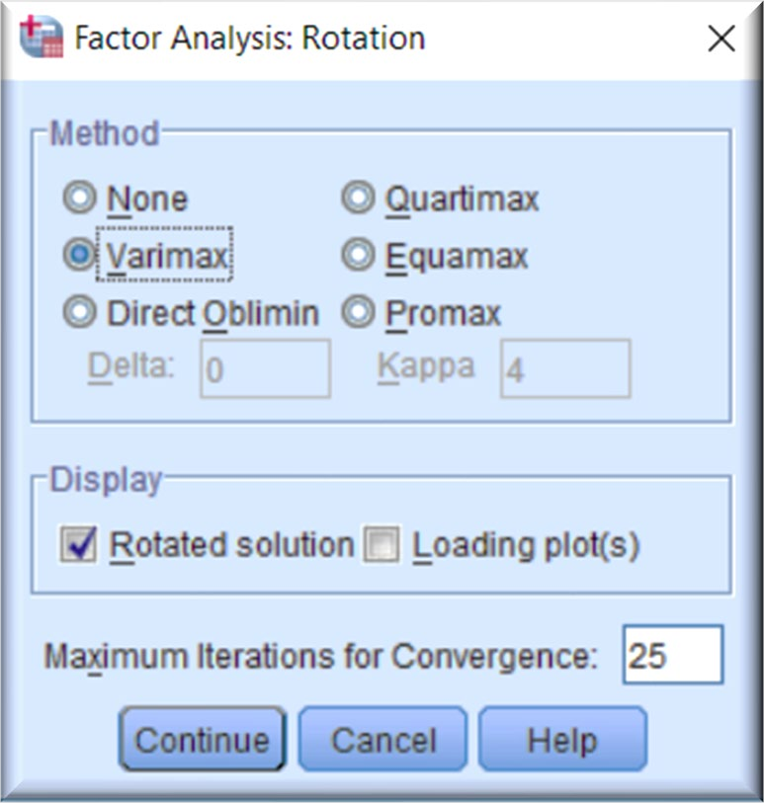
Running the Analysis: First Run
Analyze > Dimension Reduction > Factor...
Orthogonal rotation methods:
Quartimax (simplify rows of a factor matrix)
Varimax (simplify columns): most widely used.
Equimax (combination); not widely used.
Hands-on Case Study

Slide 39
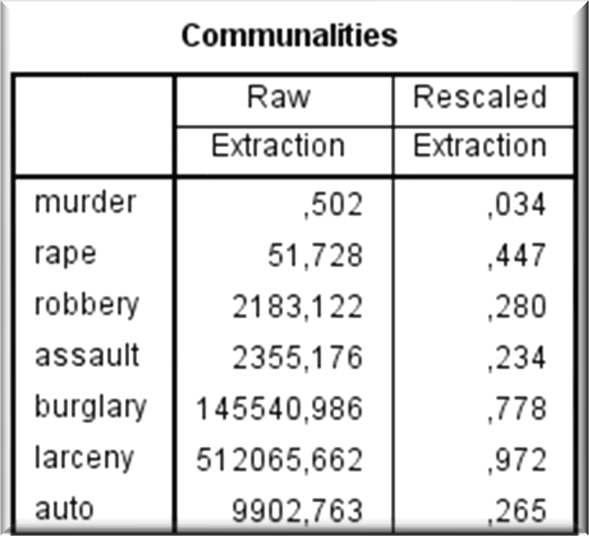
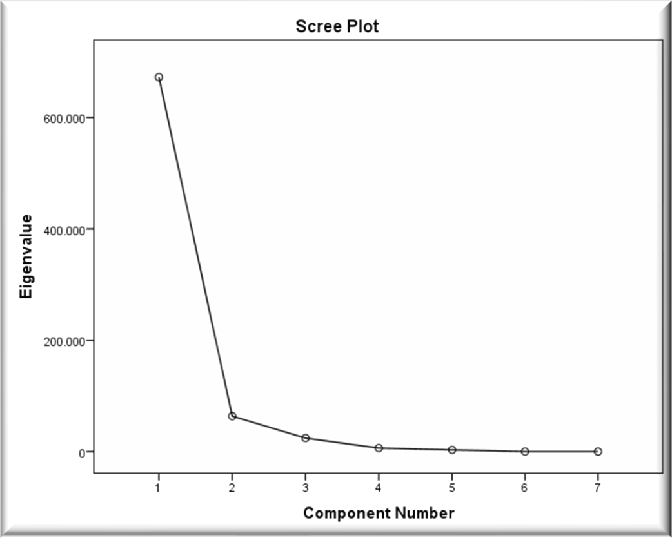
First Run: Output I
OUTPUT
Descriptive Statistics
Mean |  | Std. Deviation | Analysis N
murder | 7.4440 | 3.86677 | 50
rape | 25.7340 | 10.75963 | 50
robbery | 124.0920 | 88.34857 | 50
assault | 211.3000 | 100.25305 | 50
burglary | 1291.9040 | 432.45571 | 50
larceny | 2671.2880 | 725.90871 | 50
auto | 377.5260 | 193.39442 | 50
Extraction communalities are estimates of the variance in each variable accounted for by the components.
The communalities in this table are very low for murder, robbery, assault and auto.
Need to extract another component.
INTERPRETATION
Burglary and larceny account for most of variation in data.
Different measurement scale →
Correlation matrix
Scree plot indicate that one principle component accounts for most of variation in dataset.
The results of PCA depend on the measurement scales.
Variables with the highest simple variance tend to be emphasized in the first few principle components.
PCA using the covariance function should only be considered if all variables have the same units of measurement.
• Conclusion: choose a correlation matrix ; Covariance matrix is not appropriate, and extract more PC.
39

Slide 40

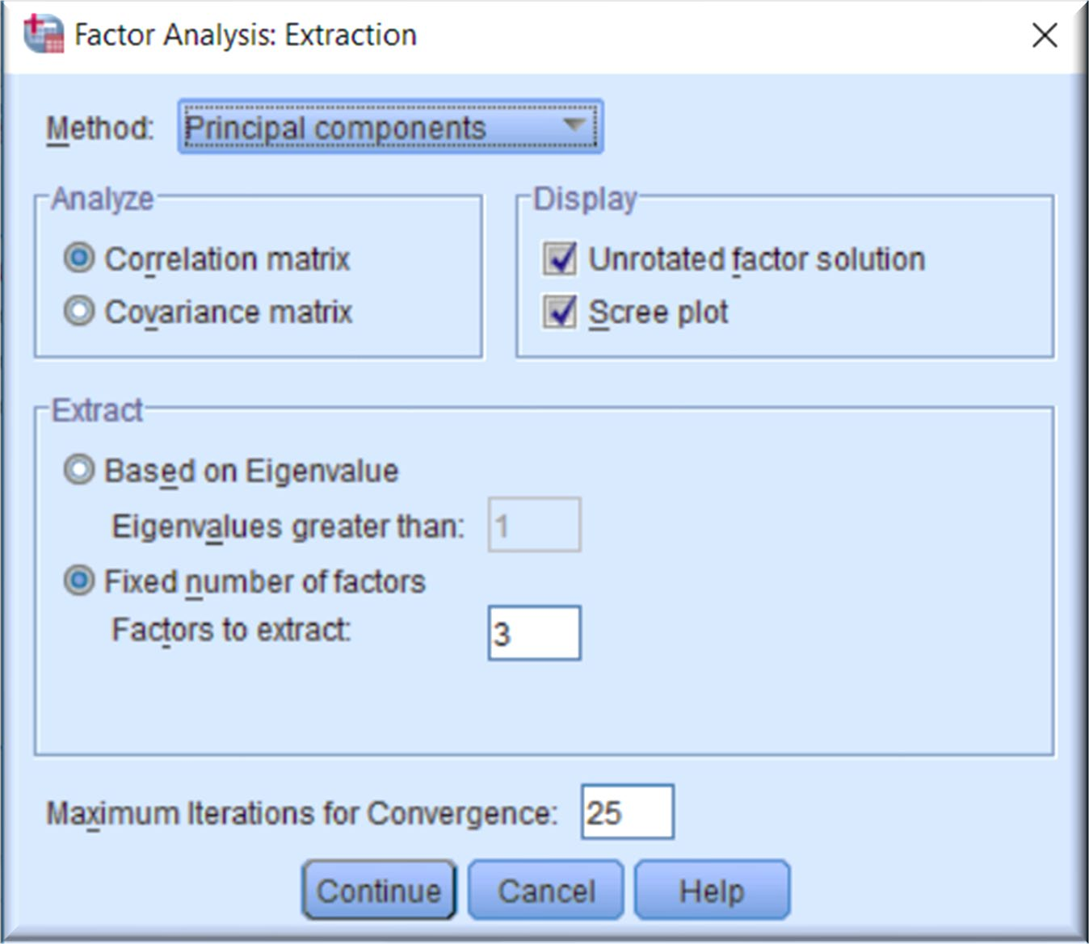
Second Run
Analyze > Dimension Reduction > Factor
Descriptive
Analyze > Dimension Reduction > Factor
Extraction
Hands-on Case Study

Slide 41
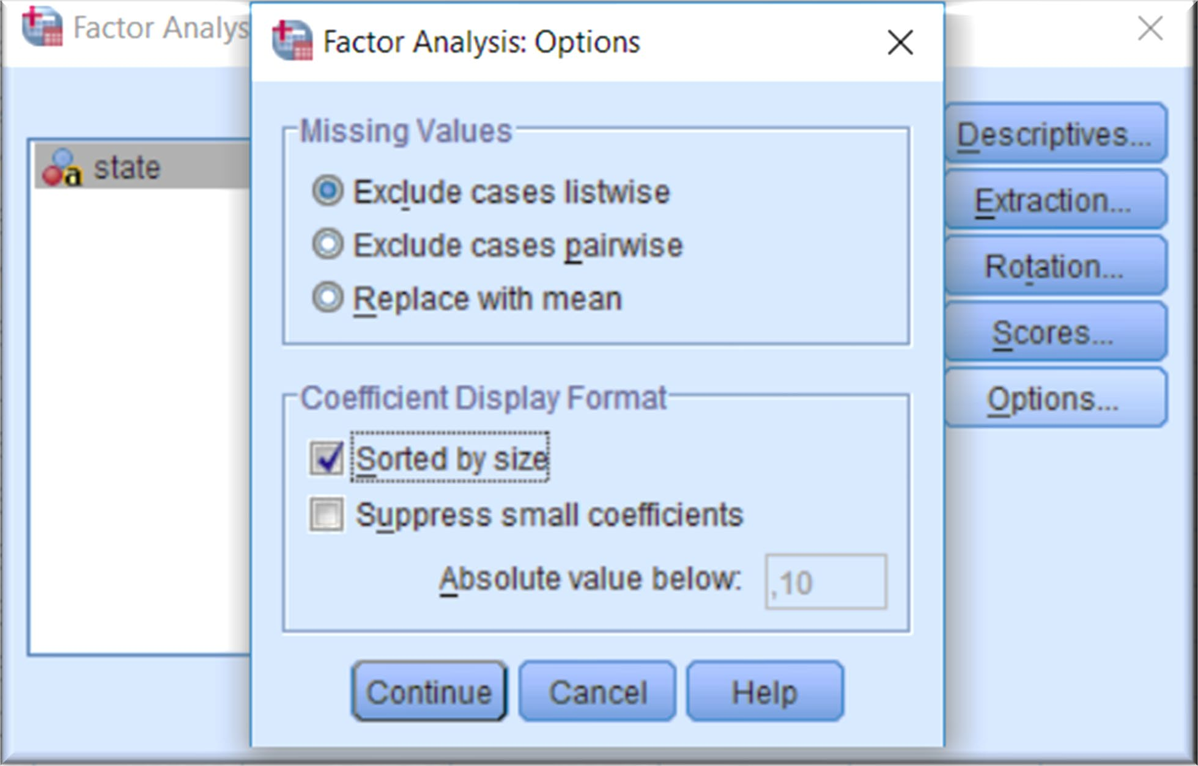
Second Run
Analyze > Dimension Reduction > Factor > Options
Click on Continue
and then OK
Hands-on Case Study

Slide 42
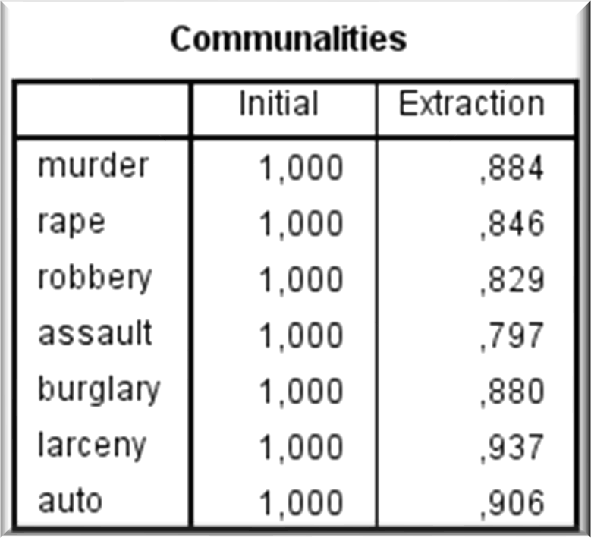
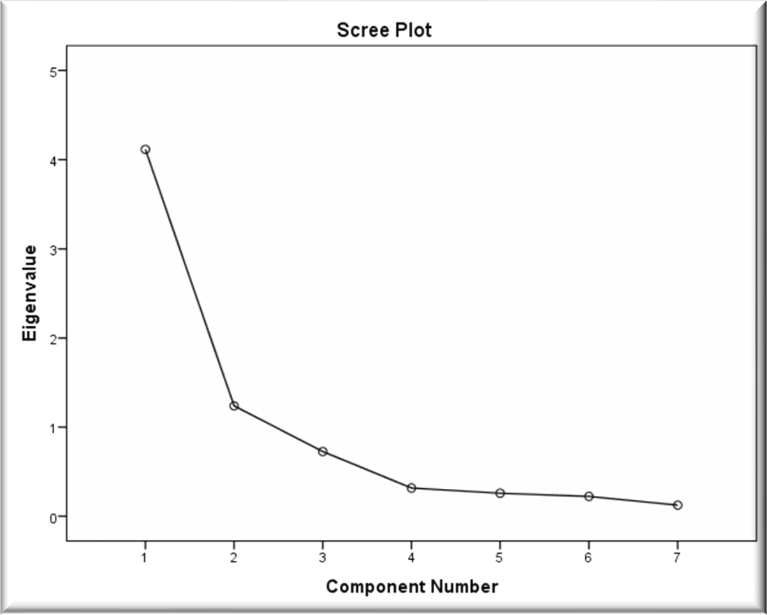
Communalities & Scree Plot
OUTPUT
INTERPRETATION
Extraction communalities are estimates of the variance in each variable accounted for by the components. The communalities in this table are all high, which indicates that the extracted components represent the variables well.
The scree plot helps you to determine the optimal number of components. The eigenvalue of each component in the initial solution is plotted.
Generally, you want to extract the components on the steep slope. The components on the shallow slope contribute little to the solution. The last big drop occurs between the third and fourth components, so using the first three components is an easy choice.
Hands-on Case Study

Slide 43
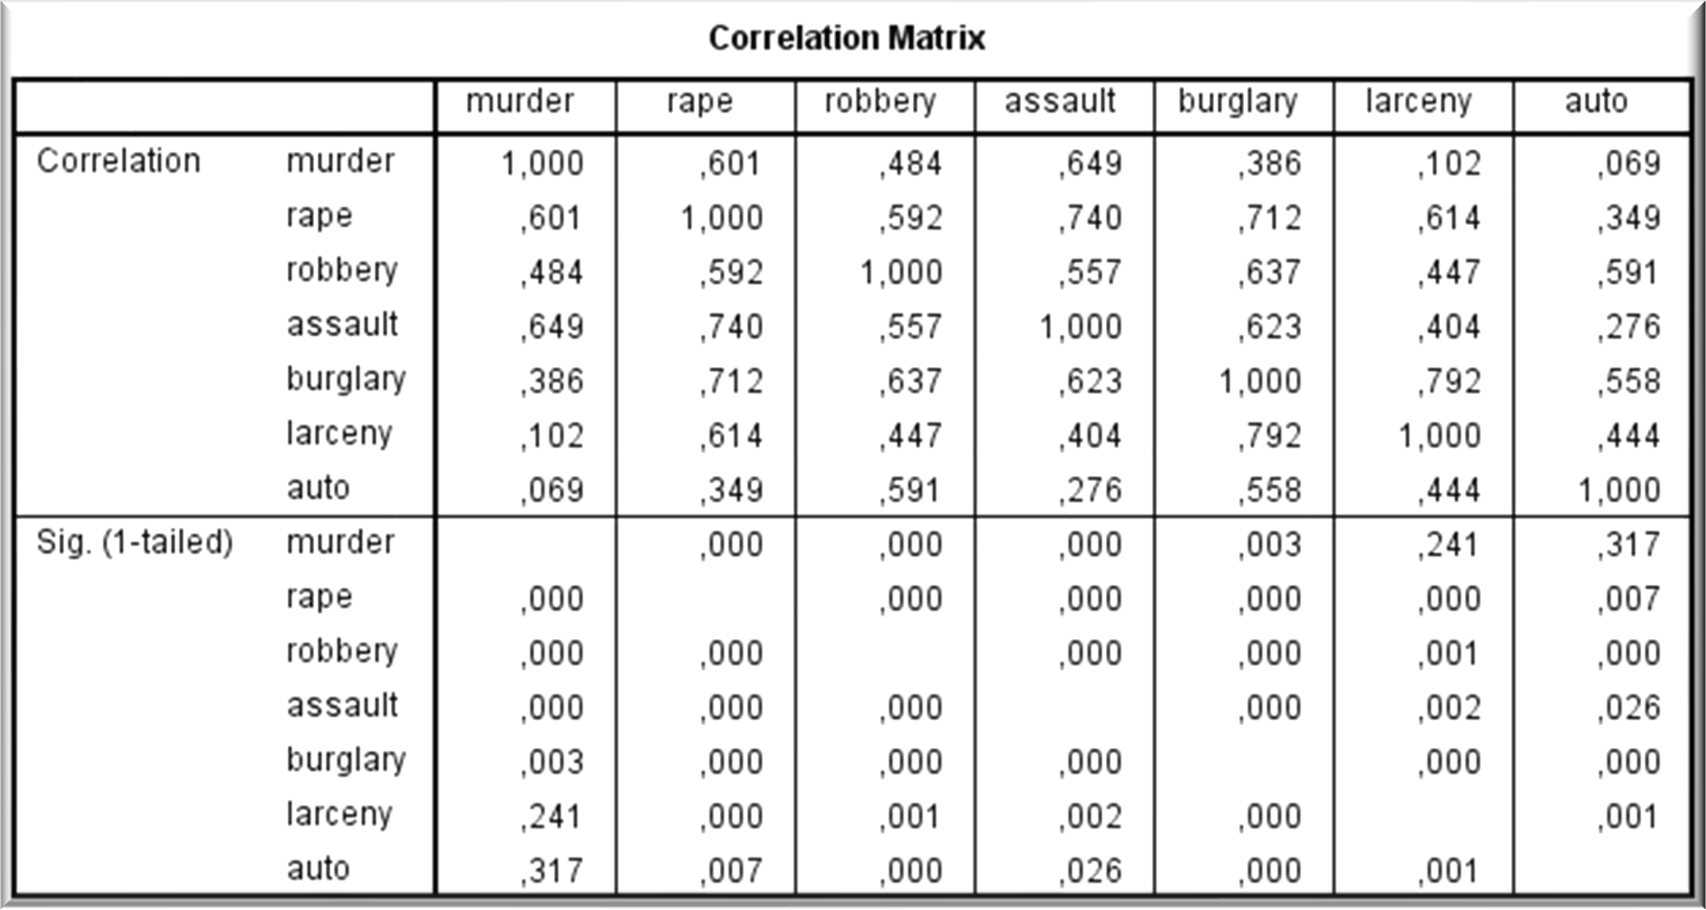
Correlation Matrix
Correlation test of significance is one tail t test (Ho: r = 0; H1: r > 0 or r < 0)
Murder is highly significantly correlated with rape, robbery, and assault.
Hands-on Case Study

Slide 44
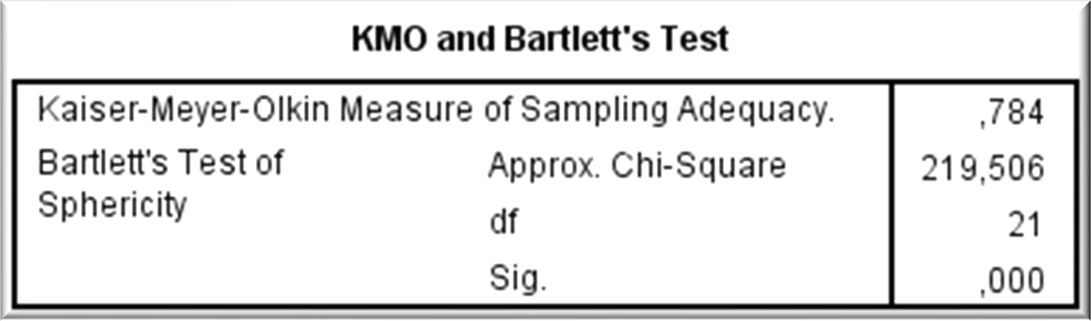
KMO and Bartlett’s Test
Kaiser-Meyer-Olkin (KMO) Test for Sampling Adequacy is a measure of how suited your data is for Factor Analysis.
The test measures sampling adequacy for each variable in the model and for the complete model. The statistic is a measure of the proportion of variance among variables that might be common variance. The higher the proportion, the more suited your data is to Factor Analysis.
KMO returns values between 0 and 1. A rule of thumb for interpreting the statistic:
0.8 ≤ KMO ≤ 1 indicate the sampling is adequate.
KMO ≤ 0.5 indicate the sampling is not adequate.
KMO = 0 means that there are large partial correlations compared to the sum of correlations, i.e. there are widespread correlations which are a large problem for factor analysis.
Bartlett’s test for Sphericity compares your correlation matrix (a matrix of Pearson correlations) to the identity matrix. It checks if there is a redundancy between variables that can be summarized with some factors.
Fall 2019
Hands-on Case Study
https://www.statisticshowto.datasciencecentral.com/kaiser-meyer-olkin/
44

Slide 45
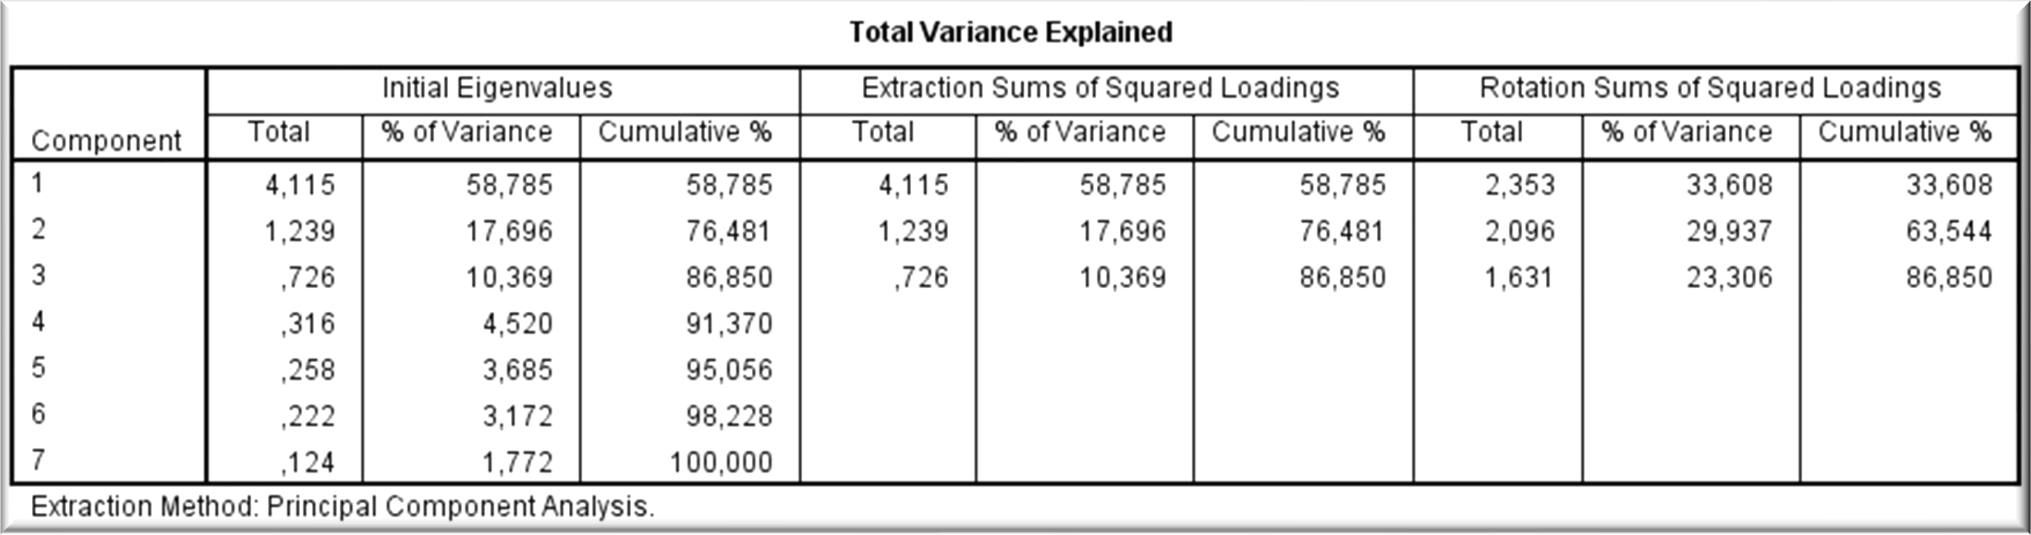
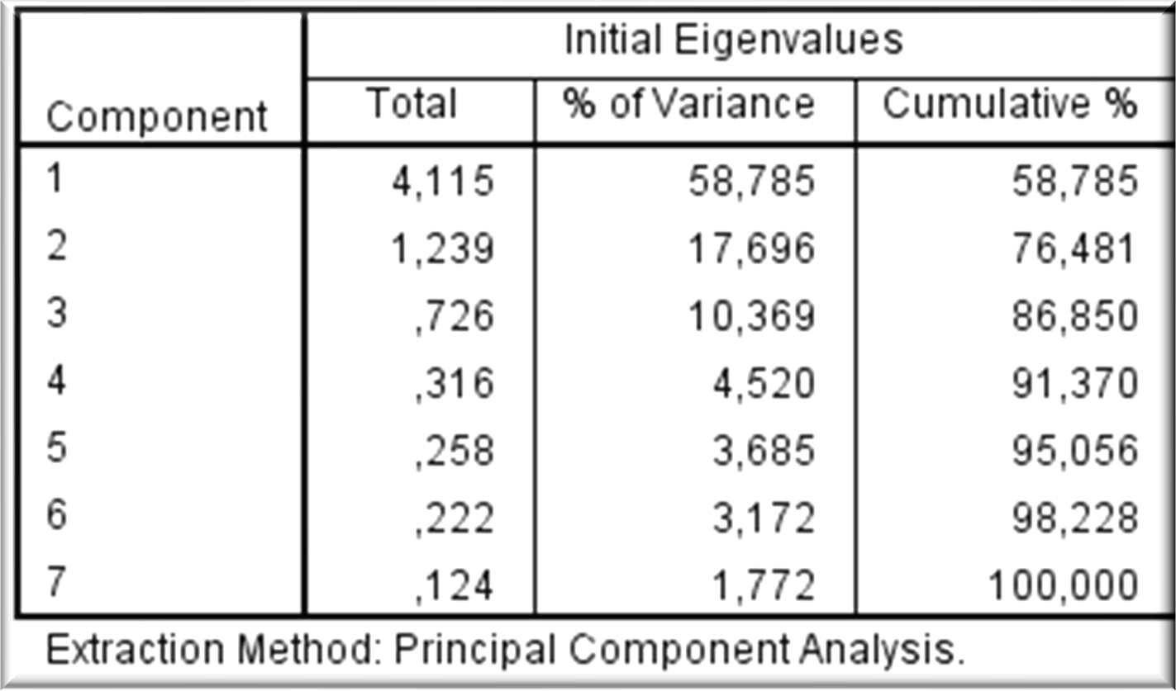
Total Variance Explained
The Total column gives the eigenvalue, or amount of variance in the original variables accounted for by each component. The % of Variance column gives the ratio, expressed as a percentage, of the variance accounted for by each component to the total variance in all variables.
The Cumulative % column gives the percentage of variance accounted for by the first n components. For example, the cumulative percentage for the second component is the sum of the percentage of variance for the first and second components.
Hands-on Case Study

Slide 46
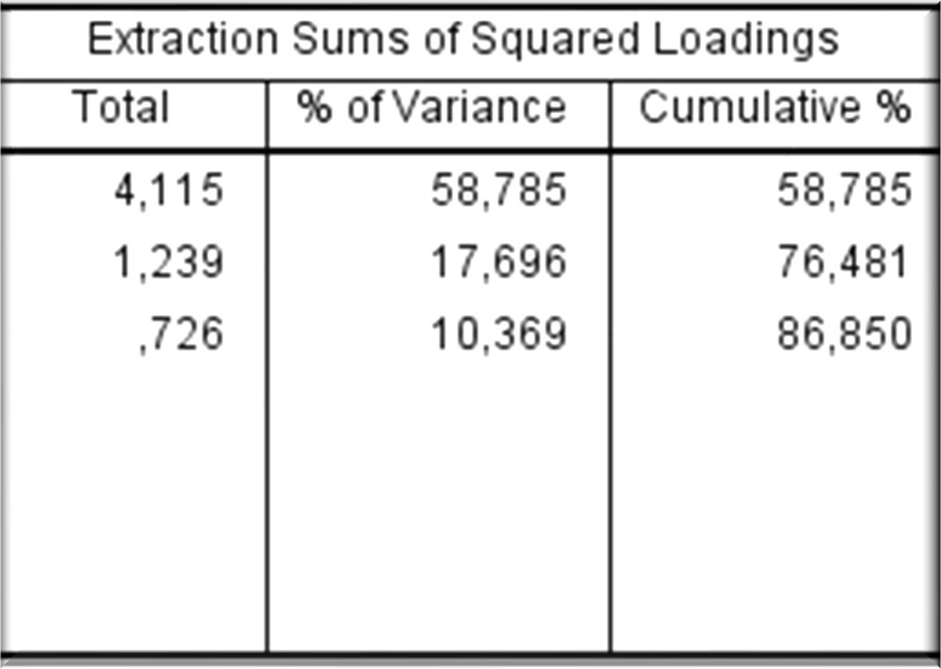
Total Variance Explained
The second section of the table shows the extracted components. They explain nearly 87% of the variability in the original 7 variables, so you can considerably reduce the complexity of the data set by using these components, with only a 13% loss of information.
Hands-on Case Study

Slide 47

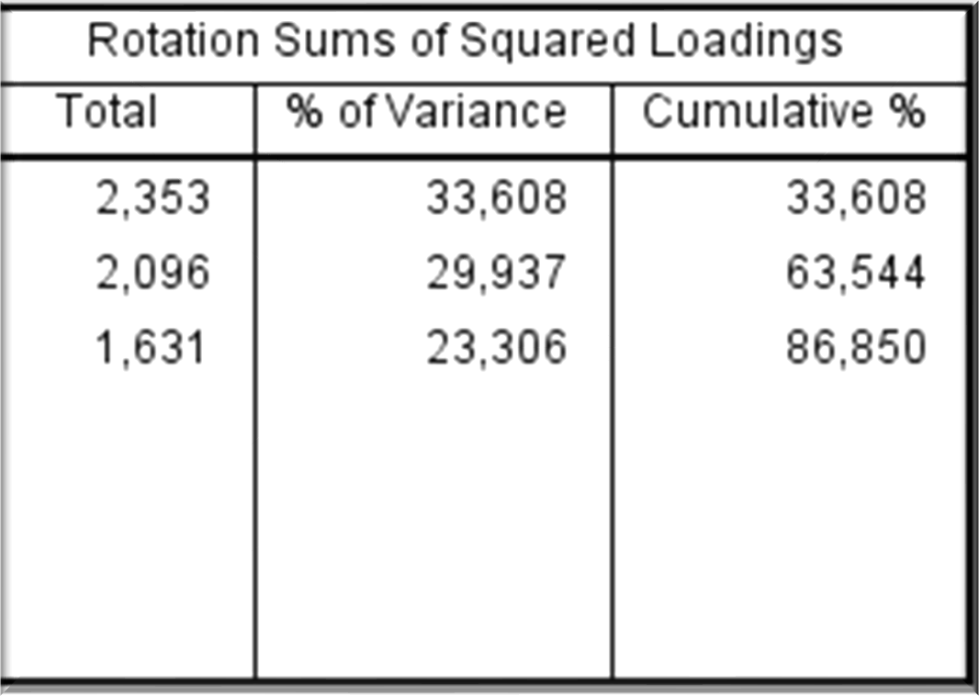
Total Variance Explained
The rotation maintains the cumulative percentage of variation explained by the extracted components, but that variation is now spread more evenly over the components. The large changes in the individual totals suggest that the rotated component matrix will be easier to interpret than the unrotated matrix.
Hands-on Case Study

Slide 48
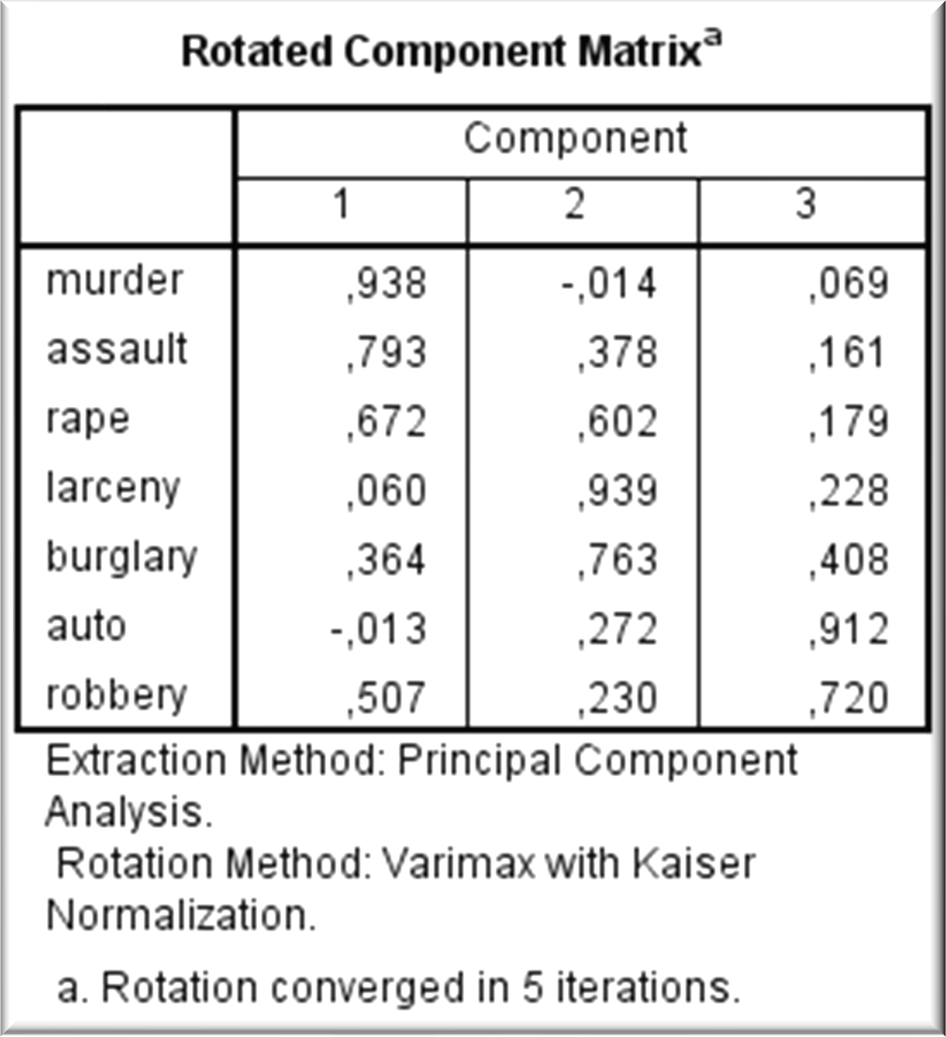
Rotated Component Matrix
The rotated component matrix helps you to determine what the components represent. The first component is most highly correlated with murder . The second component is most highly correlated with larceny. The third component is most highly correlated with auto. This suggests that you can focus on murder, larceny, and auto in further analyses, but you can do even better by saving component scores.
Hands-on Case Study

Slide 49
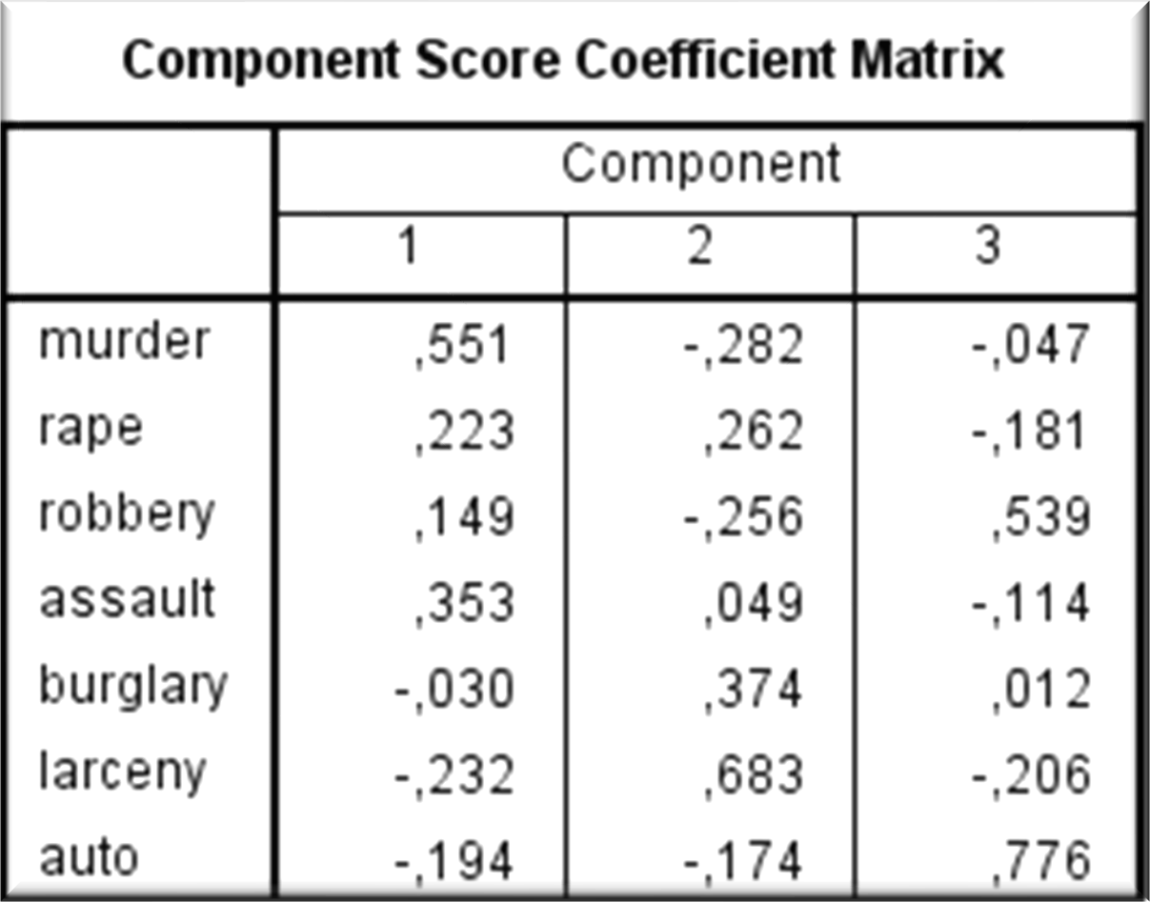
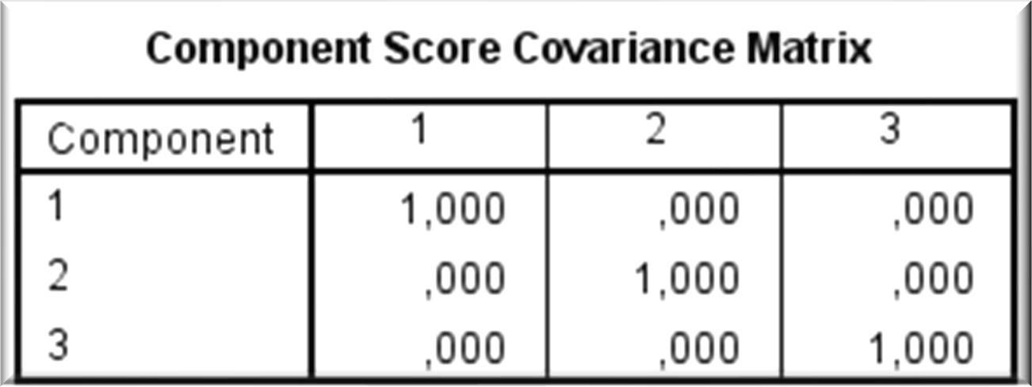
Component Score Coefficient Matrix
For each case and each component, the component score is computed by multiplying the case's standardized variable values by the component's score coefficients. The resulting three component score variables are representative of, and can be used in place of, the seven original variables with only a 13% loss of information.
Using the saved components is also preferable to using murder, larceny, and auto because the components are representative of all 7 original variables, and the components are not linearly correlated with each other.
Although the linear correlation between the components is guaranteed to be 0, you should look at plots of the component scores to check for outliers and nonlinear associations between the components.
Hands-on Case Study

Slide 50
Interpreting the PC
An optimal structure exists when all variables have high loadings only on a single factor.
Variables that cross-load (load highly on two or more factors) are usually deleted unless theoretically justified or the objective is strictly data reduction.
Variables should generally have communalities of greater than .50 to be retained in the analysis.
Respecification of a factor analysis can include options such as:
deleting a variable(s),
changing rotation methods, and/or
increasing or decreasing the number of factors.
Hands-on Case Study

Slide 51
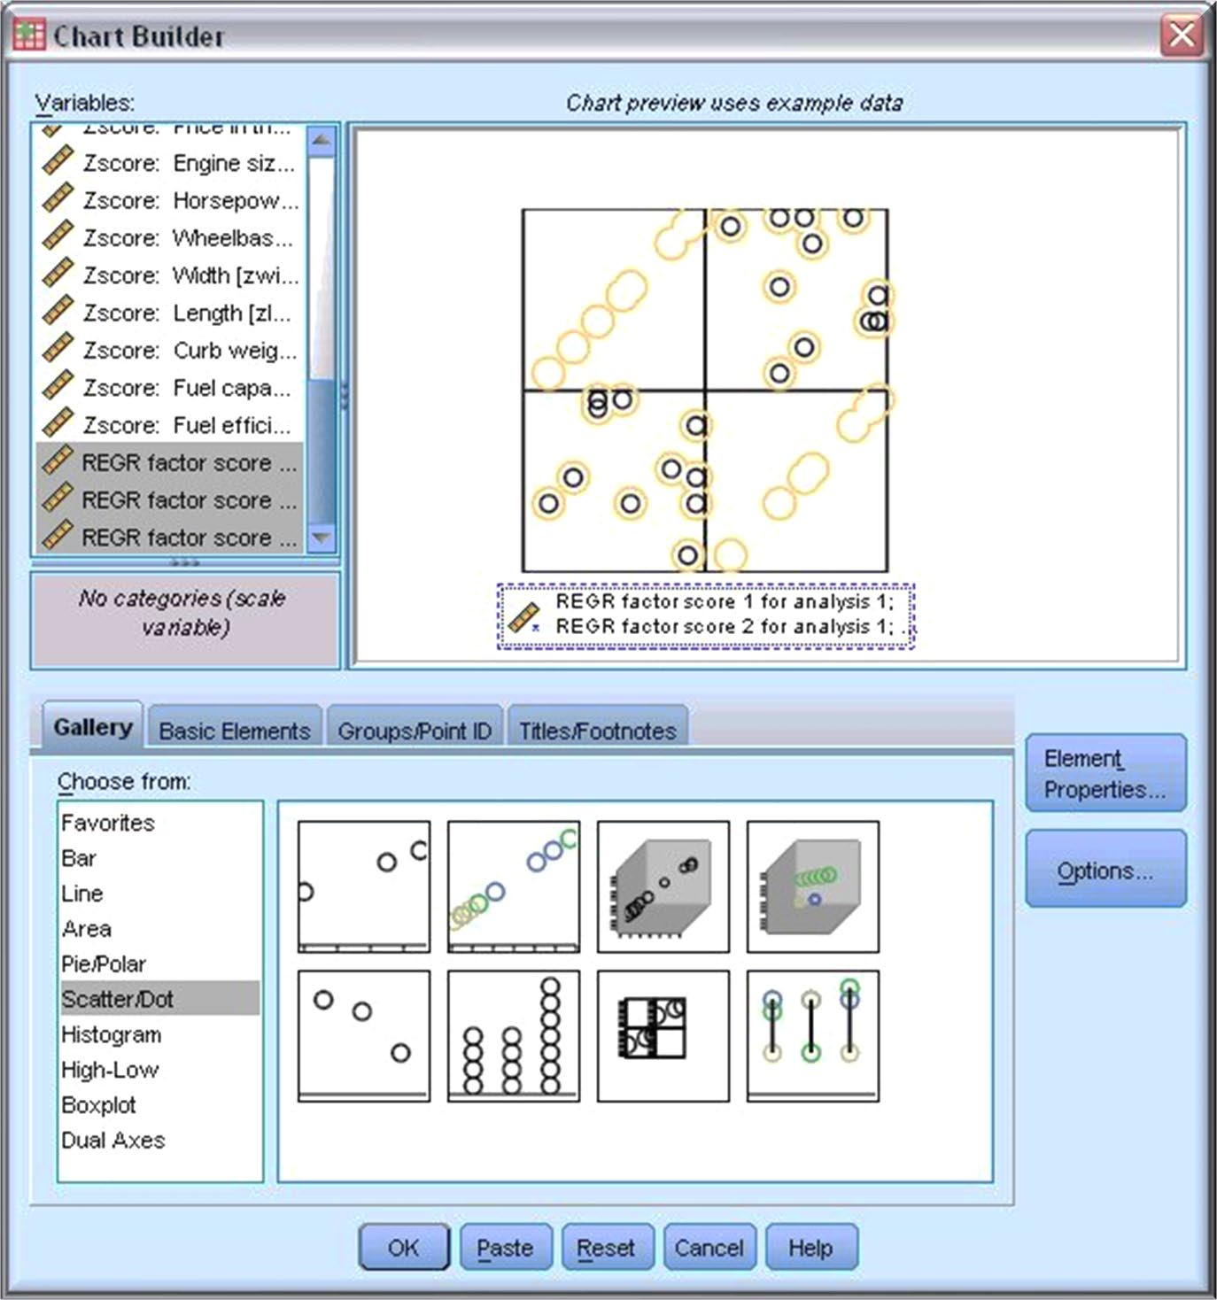
Scatterplot Matrix of Component Scores
To produce a scatterplot matrix of the component scores, from the menus choose: Graphs > Chart Builder...
Click the Gallery tab, select Scatter/Dot for the chart type, and drag and drop the Scatterplot Matrix icon to the canvas.
Select REGR factor score 1 for analysis 1 through REGR factor score 3 for analysis 1 as the matrix variables.
Click OK
Hands-on Case Study

Slide 52
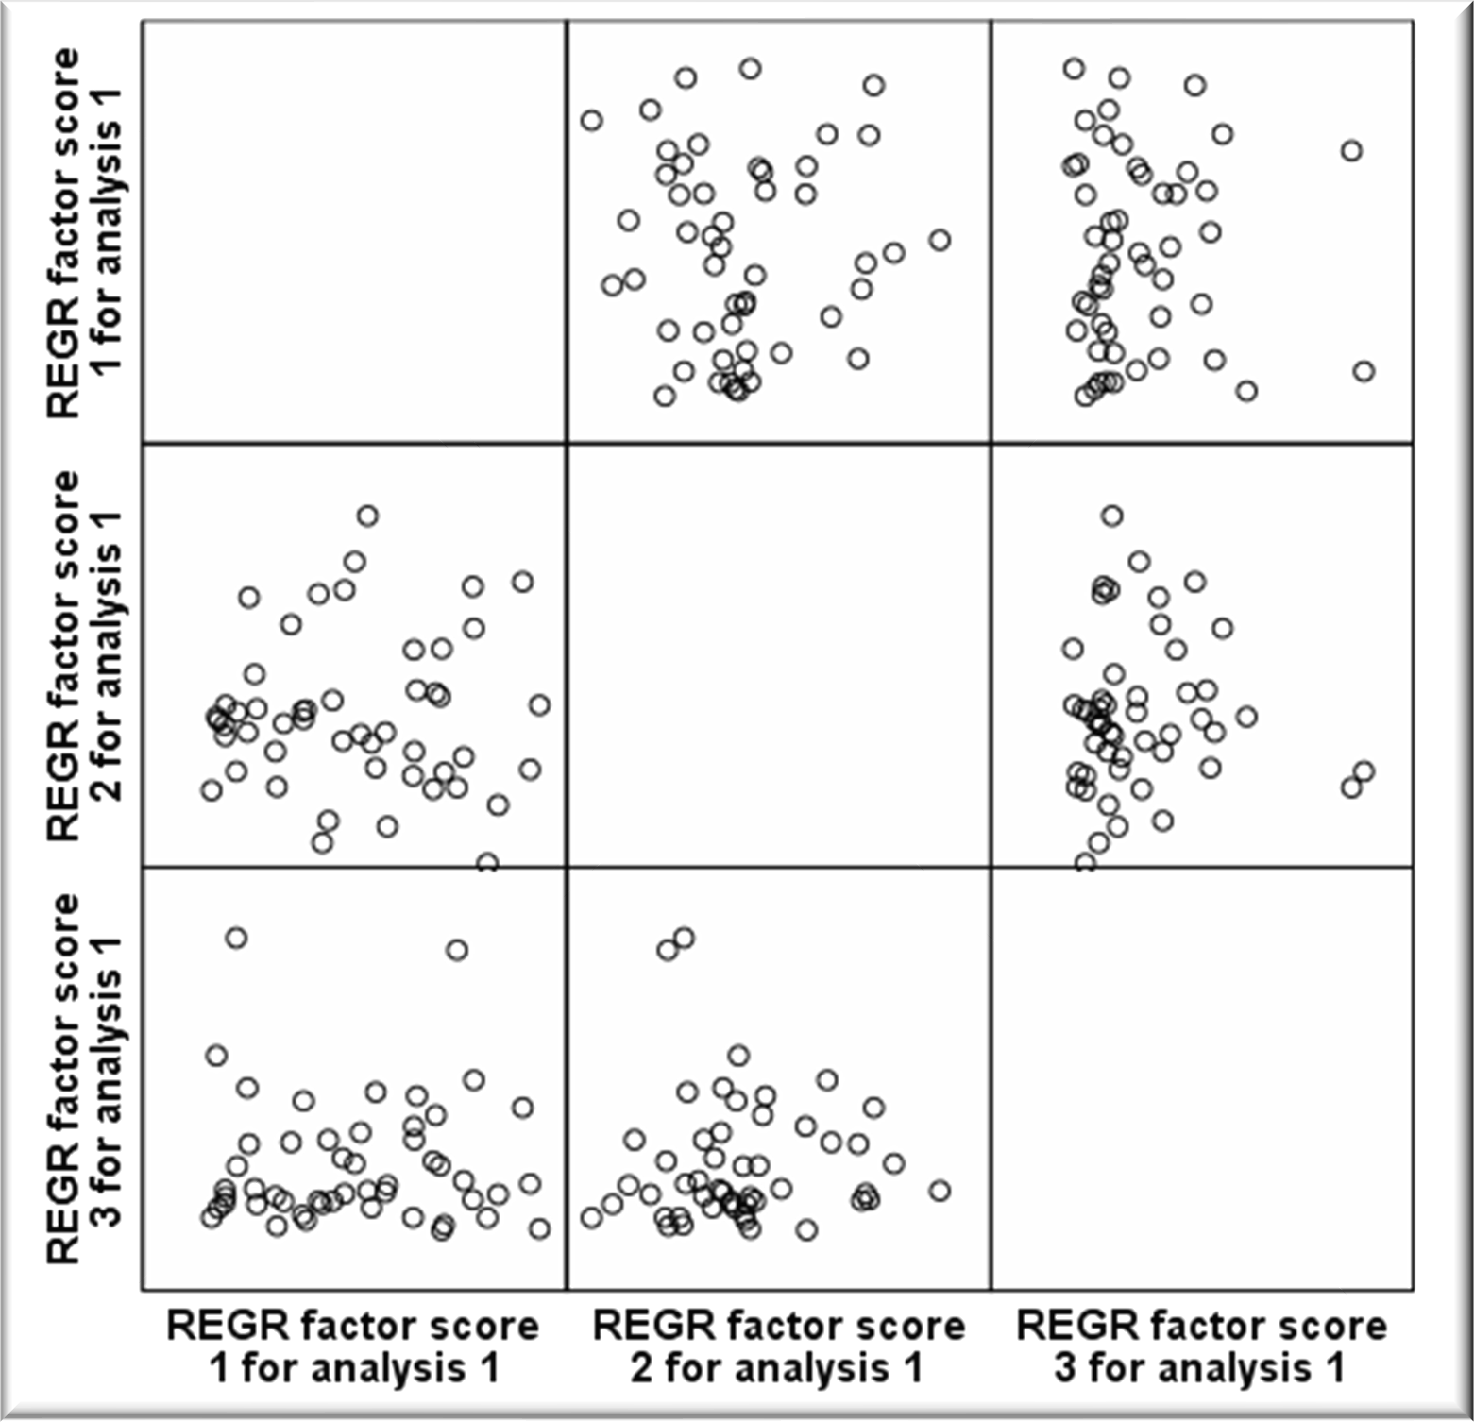
Scatterplot Matrix
The first plot in the first row shows the first component on the vertical axis vs the second component on the horizontal axis, and the order of the remaining plots follows from there.
There appear to be no correlation between the principle components.
Hands-on Case Study

Slide 53
Take-Home message
In a PCA, the eigenvalues represent the variance of each PC.
Each principle component is a linear combination of all variables, each weighted by a factor that represent the coordinates of the corresponding eigenvector.
Choosing the number of eigenvalues and hence principle component involves balancing between small number that still account for most of the variation in a data set
Take-home message

Slide 54
Homework
Three datasets: Olympics88, employee data, and credit risk.
On each of these data sets, run a principle component analysis using SPSS
Use the output to answer the following questions:
Describe your data.
Is PCA an adequate test to run?
How many principle components will you extract from your data?
Is your PCA based on correlation or covariance matrix and why?
Write the equations of all principle component? Find the variance of each
Explain the meaning of these principle components?
Are the PCs correlated? Normally distributed?
Run common factor analysis on your data? How is this different from PCA?
ALL ANSWERS SHOULD BE JUSTIFIED WITH APPROPRIATE TESTS, GRAPHS AND/OR TABLES.
Homework

Slide 55
Stage 6: Validation
Confirmatory Perspective: Structural Equation Modelling
Assessing Factor Structure Stability.
Detecting Influential Observations.
Hands-on Case Study

Slide 56


56

Slide 57

References
Joseph, F. Hair Jr, William C. Black, Barry J. Babin & Ralph E. Anderson. Multivariate Data Analysis. Pearson. 7th edition.
Chapter 4.
https://georgemdallas.wordpress.com/2013/10/30/principal- component-analysis-4-dummies-eigenvectors-eigenvalues- and-dimension-reduction/
IBM SPSS Statistics help
http://psych.colorado.edu/~carey/courses/psyc7291/classd atasets.htm
Fall 2019
Hands-on Case Study
57

